Slide 1
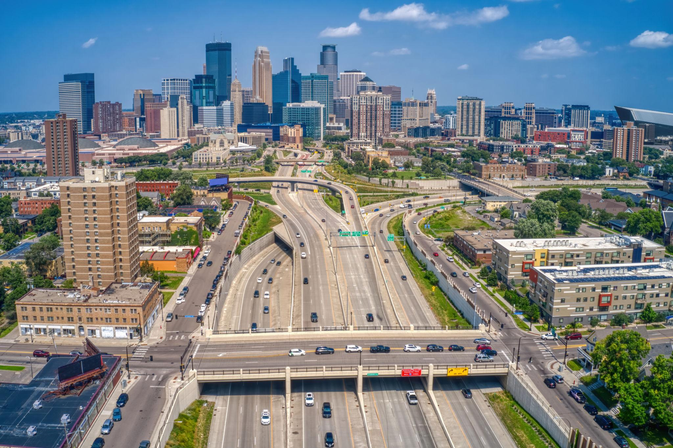
US Minneapolis Metro Traffic Pattern Analysis
Presented by Lavanya

Slide 2
Project Overview
Objective
Analyze traffic volume patterns.
Understand the impact of weather conditions on traffic.
Identify congestion trends and traffic density levels.
Create an interactive Power BI dashboard.
Dataset
Metro Interstate Traffic Volume Dataset
48,204 records
Traffic and weather-related features

Slide 3
Features | Description
holiday | Public holiday indicator
temp | Temperature (Kelvin)
rain_1h | Amount of rainfall recorded in one hour (mm/hr)
snow_1h | Amount of snowfall recorded in one hour (mm/hr)
clouds_all | Cloud cover percentage
weather_main | Main weather condition
weather_description | Detailed weather condition
date_time | Date and time of observation
traffic_volume | Number of vehicles recorded

Slide 4
Tools & Technologies Used
Tools
Google Colab
Power BI
GitHub
Libraries
Pandas
NumPy
Matplotlib
Seaborn
Plotly Express

Slide 5
Data Preprocessing
Steps Performed
Loaded dataset
Checked missing values
Handled null values
Checked duplicates
Renamed columns
Converted Date_Time datatype
Created Traffic Density feature
Exported cleaned dataset

Slide 6
Original Column | Transformed Column
holiday | Holiday_Name
temp | Temperature
rain_1h | Rainfall_Per_Hr
snow_1h | Snowfall_Per_Hr
clouds_all | Cloud_Cover_Percentage
weather_main | Weather_Condition
weather_description | Weather_Description
date_time | Date_Time
traffic_volume | Traffic_Volume

Slide 7
Feature Engineering
Traffic Density Categories
Simplifies traffic analysis
Helps identify congestion levels
Traffic Volume | Density
0–1000 | Very Low
1000–3000 | Low
3000–5000 | Moderate
5000–6000 | High
6000–7500 | Very High

Slide 8
Exploratory Data Analysis
Measures
slicers
Bar Chart
Line chart
Area chart
Pie chart

Slide 9
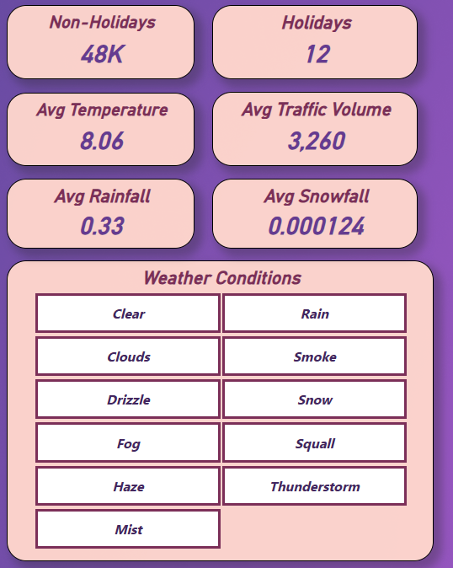
Measures & Slicers

Slide 10
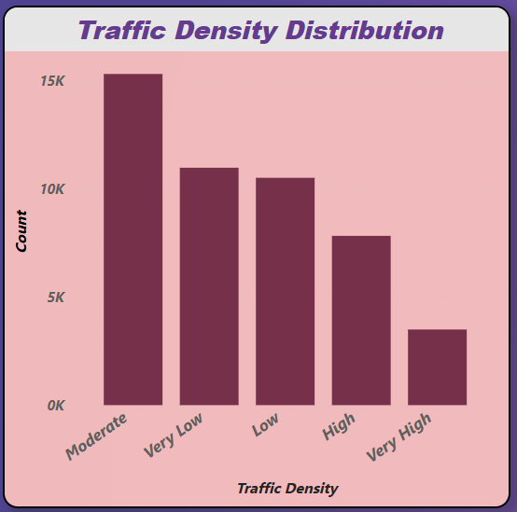
✔ Moderate traffic density has the highest number of observations.
✔ Very High traffic density occurs least frequently.
✔ Most traffic conditions fall within the Moderate to High range, indicating regular congestion on the roadway.

Slide 11
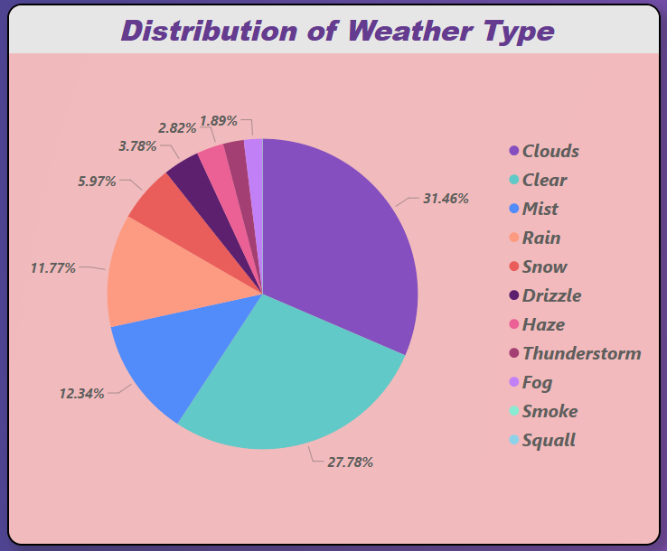
✔ Clouds represent the largest weather category, accounting for approximately 31% of observations.
✔ Clear weather is the second most common condition.
✔ Extreme weather events such as thunderstorms, fog, and squalls occur infrequently.

Slide 12
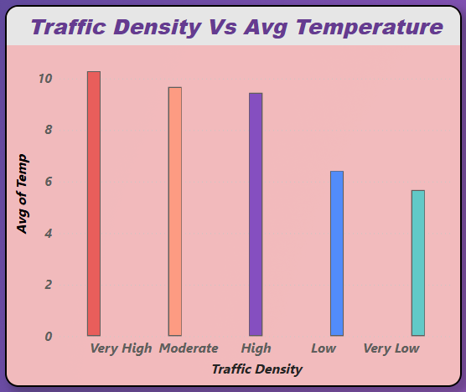
✔ Higher traffic density categories generally experience slightly higher average temperatures.
✔ Temperature differences across traffic density levels are relatively small.
✔ Temperature alone does not appear to be a major driver of traffic congestion.

Slide 13
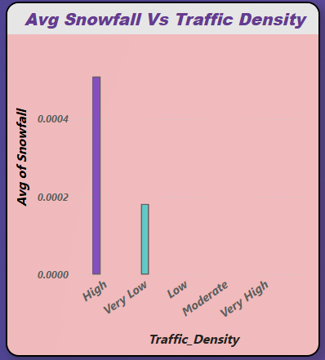
✔ Noticeable snowfall is observed mainly during High and Very Low traffic density categories.
✔ Snowfall levels remain very low overall.
✔ Snow has a limited impact on overall traffic patterns due to its low occurrence.

Slide 14
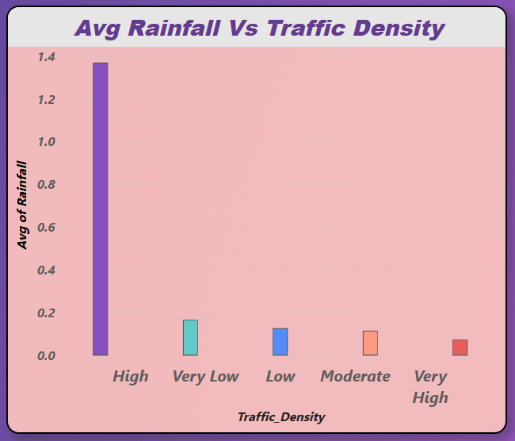
✔ High traffic density shows the highest average rainfall level.
✔ Rainfall decreases significantly across the remaining traffic density categories.
✔ Rainy conditions may contribute to slower traffic movement and increased congestion.

Slide 15
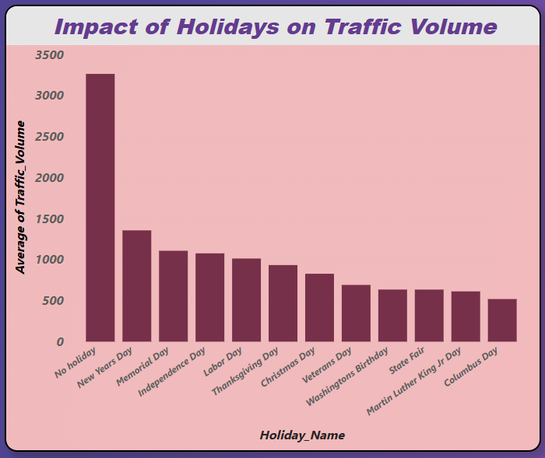
✔ Traffic is usually higher on normal days than on holidays.
✔ New Year's Day has the highest traffic among all holidays because more people travel and celebrate.
✔ Most holidays have less traffic than regular days because fewer people go to work or commute.

Slide 16
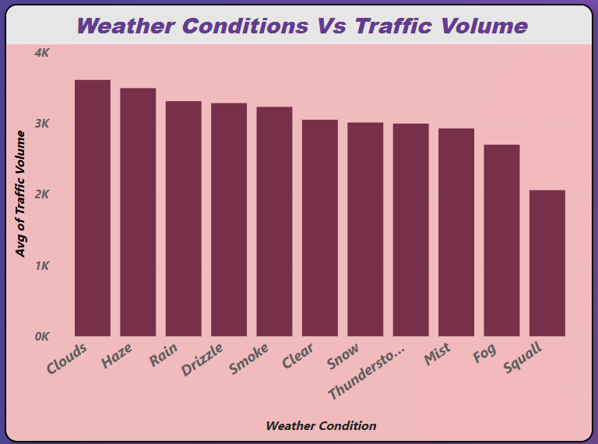
✔ Traffic volume is highest during Cloudy, Haze, and Rainy conditions.
✔ Squall conditions record the lowest average traffic volume.
✔ Traffic demand remains relatively high across most weather conditions.

Slide 17
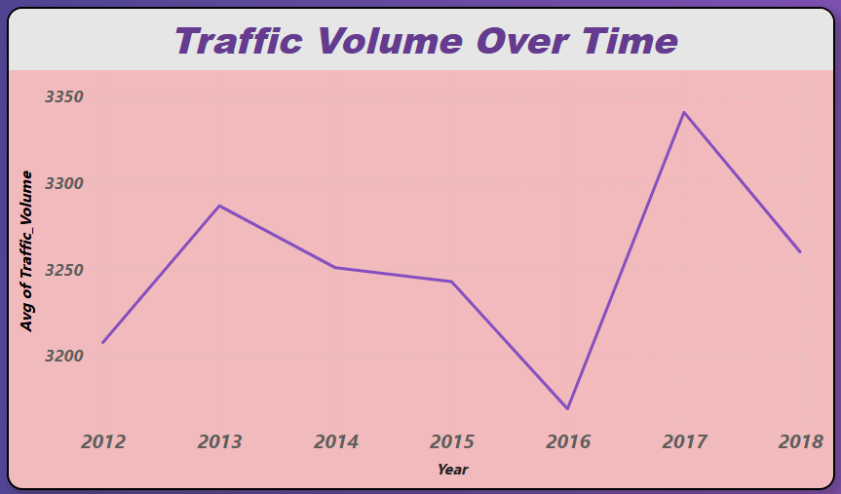
✔ Traffic volume remains relatively stable across the years.
✔ A peak in average traffic volume is observed around 2017.
✔ No significant long-term decline in traffic demand is evident.

Slide 18

Recommendations

Slide 19
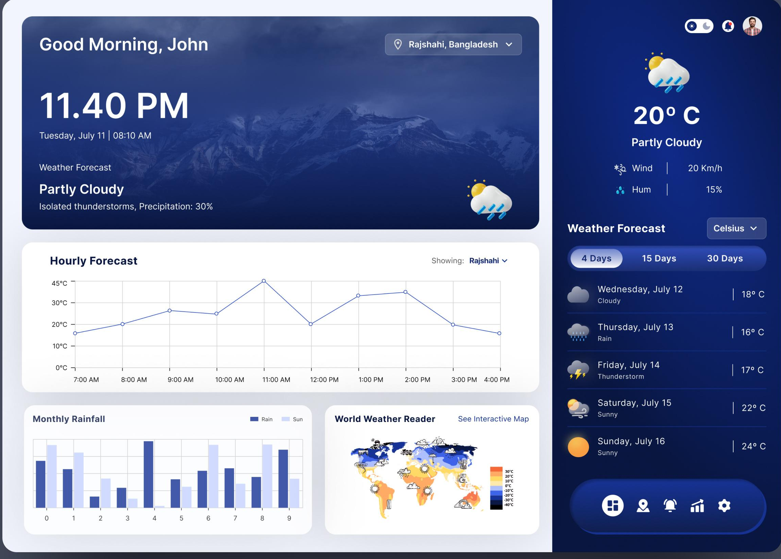

✔ Use weather forecasts to prepare for heavy traffic during rainy periods

Slide 20

✔ Focus traffic management efforts during Moderate and High traffic periods

Slide 21
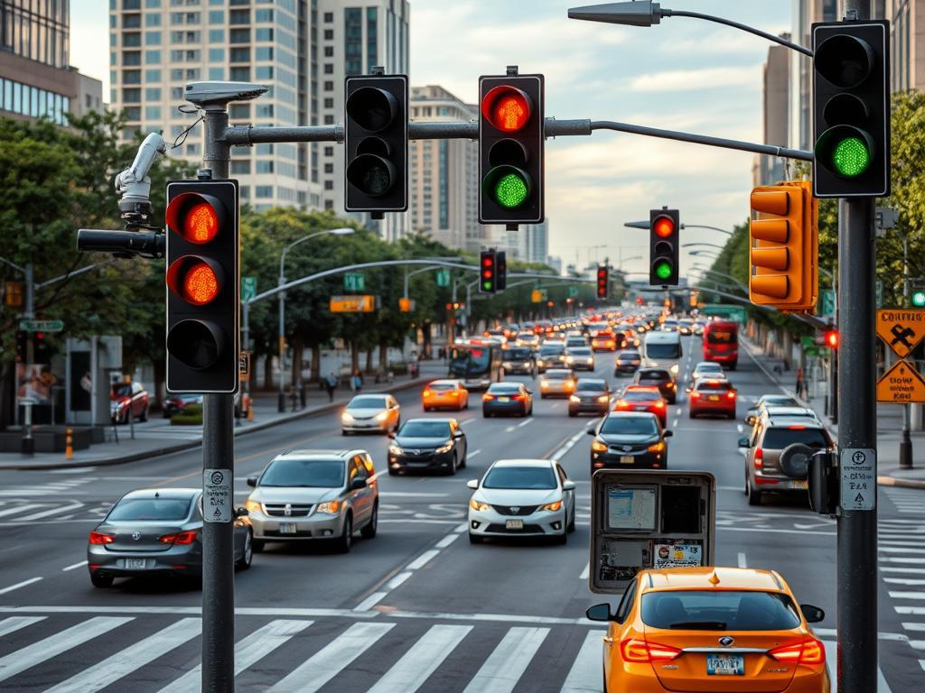
✔ Optimize traffic signals during peak traffic hours

Slide 22
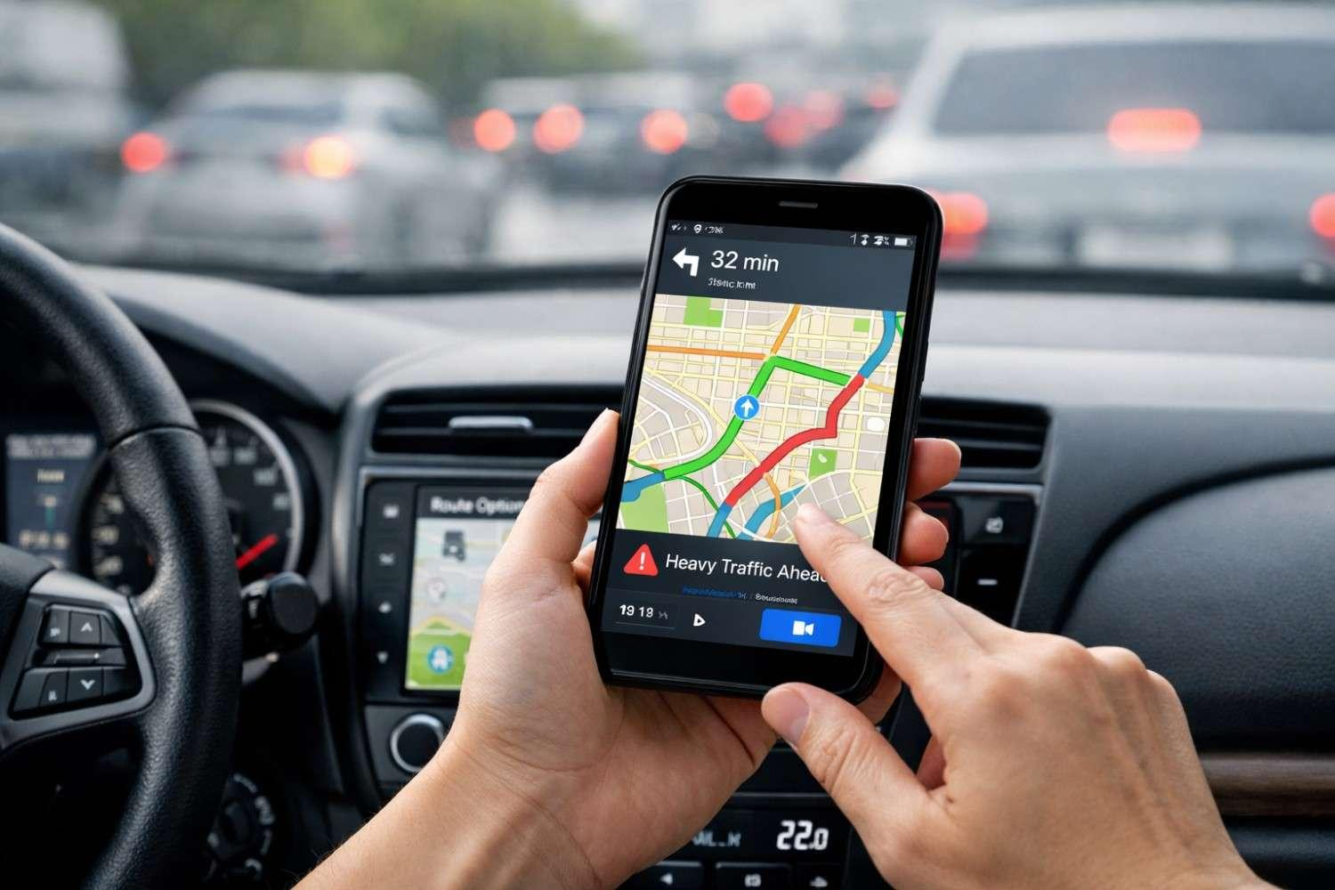
✔ Provide alternate routes to reduce traffic delays

Slide 23
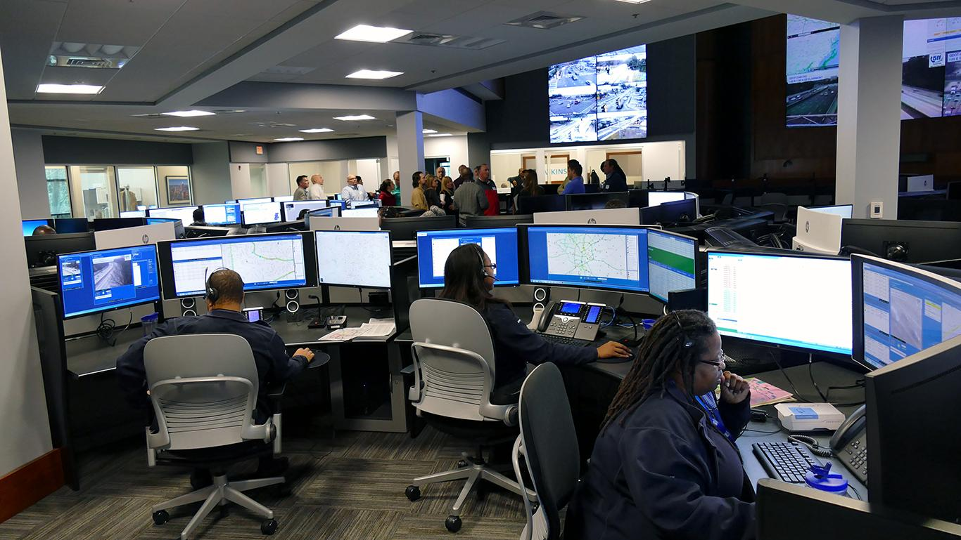
✔ Monitor weather-related traffic disruptions proactively

